Slide 1
Agile Development with IoC and ORM
James Kovacs
JamesKovacs.com | Pluralsight.com
jkovacs@post.harvard.edu
@jameskovacs

Slide 2
Quick Survey

Slide 3


Slide 4
Introduction to IoC

Slide 5
Dependency Inversion
High-level modules should not depend on low-level modules. Both should depend on abstractions.
                Robert C. Martin

Slide 6
Dependency Injection
Dependencies are provided to objects via constructor or properties
  Constructor injection
  Setter injection
Prefer constructor injection for required dependencies
Prefer setter injection for optional dependencies

Slide 7
Lab: Poor Man’s Dependency Injection
Create a CustomerService that depends on a CustomerRepository
Use Poor Man’s to wire them together

Slide 8
Inversion of Control Containers
Hashtable of interface vs. implementing type
  In simplest form, basically:
Dictionary<Type, object>
Full-fledged containers offer a lot more...

Slide 9
Popular Containers
Windsor
  http://www.castleproject.com/container
StructureMap
  http://structuremap.sourceforge.net
Spring.NET
  http://www.springframework.net
Unity
  http://codeplex.com/unity
Ninject
  http://ninject.org
Autofac
  http://code.google.com/p/autofac

Slide 10
Why Use Popular Container?
Wider configuration options
  XML, code, script
Lifetime management
  Singleton, transient, per-thread, or pooled
Auto-wiring dependencies
Run-time configurability
Plug-ins

Slide 11
Lab: Castle Windsor
Change your previous lab to use Castle Windsor

Slide 12
One Assembly to Rule Them All
Common Service Locator
  http://www.codeplex.com/CommonServiceLocator
public interface IServiceLocator : IServiceProvider {
object GetInstance(Type serviceType);
object GetInstance(Type serviceType, string key);
IEnumerable<object> GetAllInstances(Type serviceType);
TService GetInstance<TService>();
TService GetInstance<TService>(string key);
IEnumerable<TService> GetAllInstances<TService>();
}

Slide 13
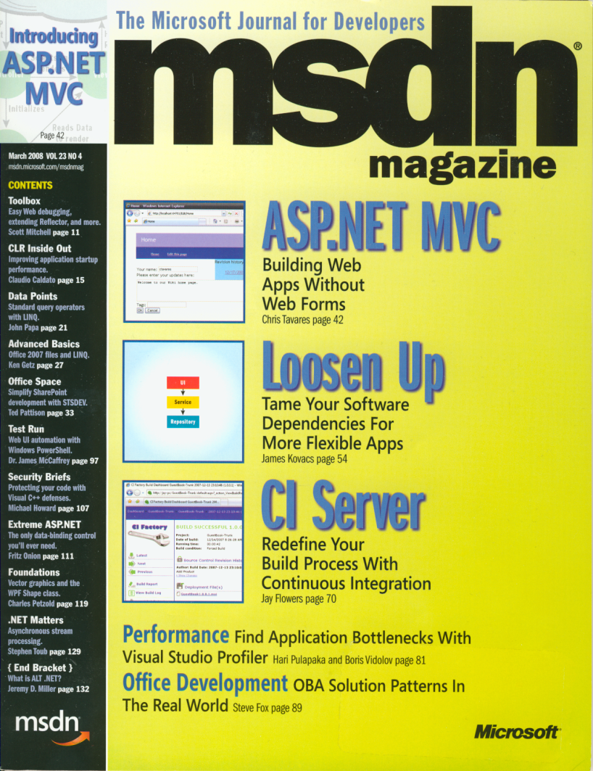

Slide 14


Slide 15
Resources
Loosen Up: Tame Your Software Dependencies for More Flexible Apps, MSDN Magazine March 2008
  http://msdn.microsoft.com/en-us/magazine/cc337885.aspx
Bricks and Mortar: Building a Castle, CoDe Magazine May/June 2009
  http://code-magazine.com/Article.aspx?quickid=0906051
Castle Windsor
  http://www.castleproject.org/container/
The Bookshelf
  http://www.jameskovacs.com/blog/TheBookshelf.aspx

Slide 16
Introduction to O/RM

Slide 17
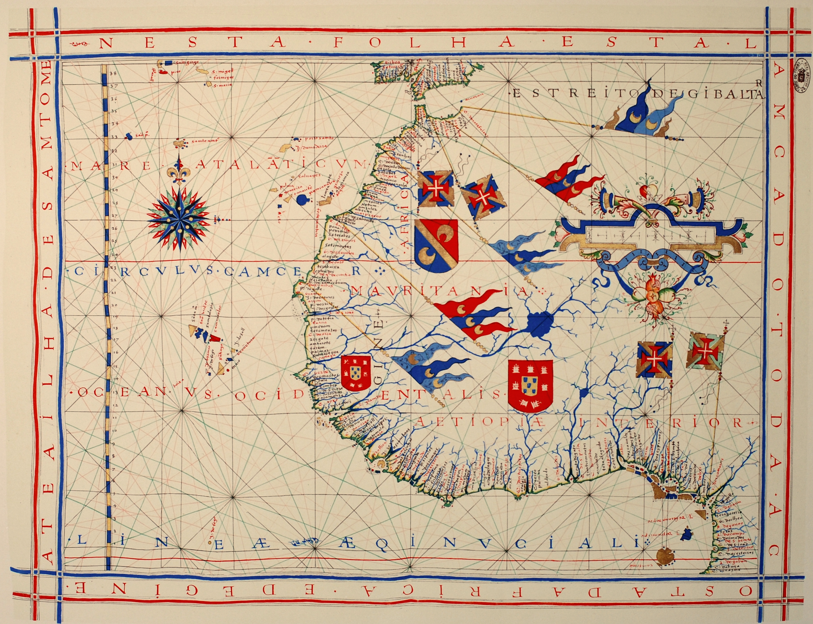

Slide 18

OO and Relational Worlds
OO
Relational
Object-based
Unidirectional associations
Pointer from owner
Inheritance
Polymorphism
Many-to-many
Set-based
Bidirectional associations
FK on owned
No inheritance
No polymorphism
Join tables

Slide 19
NHibernate

Slide 20
NHibernate Quickstart
Create hibernate.cfg.xml or use app.config
var cfg = new Configuration();
cfg.Configure();
var sf = cfg.BuildSessionFactory();
using(var s = sf.OpenSession())
using(var tx = s.BeginTransaction()) {
var c = s.Get<Customer>(42);
tx.Commit();
}

Slide 21

NHibernate API
Configuration | Class for bootstrapping NHibernate
ISessionFactory | Factory for creating sessions
ISession | Roughly analogous to a database connection
ITransaction | Abstracts underlying transaction semantics
IQuery | String-based query API aka HQL
ICriteria | Object-based query API aka Criteria
LINQ | LINQ query API for NHibernate

Slide 22

Patterns in NHibernate
Data Mapper
Identity Map
Unit of Work
Lazy Loading
And many more from Martin Fowler’s Patterns of Enterprise Application Architcture

Slide 23
Intellisense for NHibernate
Drop XSD files
  nhibernate-mapping.xsd
  nhibernate-configuration.xsd
Into
  C:\Program Files \Microsoft Visual Studio 9.0\xml\schemas
    Or
  C:\Program Files (x86)\Microsoft Visual Studio 9.0\xml\schemas

Slide 24
Lab: Initial Setup
Install Subversion client
Install VisualSVN (optional)
Download from Subversion
Install XSD files
Install ReSharper templates
Install NHibernate Plug-in 1.0
Create empty database

Slide 25
Configuration

Slide 26

NHibernate Configuration
hibernate.cfg.xml
App.config or Web.config
Run-time

Slide 27
DEMO
Configuring NHibernate

Slide 28
Lab: Configuration
Create an application
Reference assemblies
Add a configuration file
Configure NHibernate

Slide 29
Mapping

Slide 30
Mapping Basics
Class Definitions
Mapping Metadata
Database Schema

Slide 31

Mapping Metadata
XML files (hbm.xml)
NHibernate.Mapping.Attributes in NHContrib
Castle ActiveRecord
Fluent NHibernate
  ClassMap<T>
  Automaps

Slide 32
DEMO
Mapping, Schema Generation, and Simple Fetches

Slide 33
Lab: Mapping
Create a class with simple properties
Map the class using ClassMap<T>
Export the database schema
Insert some data using session.Save(obj)
Retrieve the saved data using session.Get<T>() and session.Load<T>()

Slide 34
Relationships

Slide 35
Understanding Relationships
<one-to-one name=“Person”/>
  Two tables, Customer and Person, share same PK
<one-to-many class=“Order”/> inside <set>
  Two tables, Customer and Order, with a CustomerId on the Order table
<many-to-one name=“Customer”/> on Order
  Two tables, Customer and Order, with a FK on Order pointing back to its parent Customer
<many-to-many>
  Two tables with a joining table
  Joining table has two FKs, one to each table

Slide 36
One-to-One Associations
Use <many-to-one> element
  Standard FK in parent table to child table
  E.g. Person HAS-A HomeAddress
  <many-to-one name=“HomeAddress” cascade=“all-delete-orphan”/>
    where HomeAddress is an entity with its own PK
Avoid <one-to-one> element
  Used for two tables that share the same primary key
  Typically better mapped using
    Inheritance
    <many-to-one>
  More information in NHibernate documentation

Slide 37

Sets, Lists, and Bags... Oh My!
Set
  Unordered collection of unique elements
  Mapped using Iesi.Collections.Generic.ISet<T>
List
  Ordered collection of non-unique elements
  Mapped using System.Collections.Generic.IList<T>
Bag
  Unordered collection of non-unique elements
  Mapped using System.Collections.Generic.IList<T>
Others, though not commonly used
  Map (Hashtable or Dictionary<K,T>)
  Array
  Primitive-Array
  IdBag

Slide 38

Cascades
Tells NHibernate how to handle child entities
Options:
  none – no cascades (default)
  all – cascade saves, updates, and deletes
  save-update - cascade saves and updates
  delete – cascade deletes
  all-delete-orphan - same as all and delete orphaned rows
Can specify default-cascade in hbm.xml file

Slide 39

Lazy Loading
Default for associations in NHibernate 1.2+
Requires open ISession
Fetching strategies
  Select, outer-join
Avoiding the N+1 SELECT problem

Slide 40

Understanding Inverse=“true”
Relational model
  Bidirectional associations using one FK
OO model
  Unidirectional associations using references
Bidirectional associations in the OO
  Two unidirectional associations with the same data
Inverse=“true” tells NHibernate which one to ignore
Prevents duplicate updates of FK
Prevents FK violations
“Which table owns the FK?”
  <many-to-one> and <one-to-many> collection
    inverse is <one-to-many> collection
  <many-to-many>
    choose either
N.B. Cascades are an orthogonal concept!

Slide 41
DEMO
Mapping Associations

Slide 42
Lab: Collections
Add a collection to your class
Map the collection
Load and save items to the collection

Slide 43
Inheritance

Slide 44
Mapping Inheritance Relationships
Person
-Id
-Name
Customer
-RewardStatus
Employee
-Office

Slide 45
Single table inheritance
Uses discriminator column
One table contains all possible columns
All derived class columns must be nullable
Person
Id (PK)
Name
RewardStatus (null)
Office (null)

Slide 46
Concrete table inheritance
Table per concrete class with complete columns
Uses subclass
Customer
Id (PK)
Name
RewardStatus
Employee
Id (PK)
Name
Office

Slide 47
Class table inheritance
Table per class with diff of columns
Uses joined-subclass
Person
Id (PK)
Name
Customer
Id (PK/FK)
RewardStatus
Employee
Id (PK/FK)
Office

Slide 48
DEMO
Mapping Inheritance Relationships

Slide 49
Lab: Inheritance
Add a derived class
Map the relationship using concrete-table inheritance
Save instances of base and derived types
Examine the saved rows of data
EXTRA: Try mapping with single-table and class-table inheritance

Slide 50
Querying

Slide 51

Querying
ISession.Get<T>(id) and ISession.Load<T>(id)
Hibernate Query Language (HQL)
Criteria API
Example Queries
LINQ to NHibernate

Slide 52
DEMO
Querying with HQL

Slide 53
Lab: HQL Queries
Query for customers:
  named is “John”
  names begin with “S”
Query for orders:
  shipped to Auburn
  placed in the last 6 months
http://nhforge.org/doc/nh/en/index.html#queryhql

Slide 54
DEMO
Querying with Criteria

Slide 55
Lab: Criteria Queries
Query for customers:
  named is “John”
  names begin with “S”
Query for orders:
  shipped to Auburn
  placed in the last 6 months

Slide 56
DEMO
Querying with Examples

Slide 57
Lab: LINQ
Find Addresses in Canada
Find Customers with LastName starting with S

Slide 58
DEMO
Filters, Aggregations, and Projections

Slide 59
Lab: Filters, Aggregations, and Projections
Page through SalesOrders for all Walter in the database using a Filter
Number of addresses per city
Determine the average tax paid on all orders

Slide 60
The Level 2 Cache

Slide 61
NHibernate’s Level 2 Cache
Cache providers
  Hashtable (testing only)
  ASP.NET Cache
  Prevalence Cache
  Memcache
Entity cache and query cache
<property name=“cache.provider-class”/>
  NHibernate.Cache.HashtableCacheProvider
  NHibernate.Caches.SysCache.SysCacheProvider, NHibernate.Caches.SysCache
  ...

Slide 62
Entity Cache
Via class or collection mappings
  <cache usage=“read-write|nonstrict-read-write|read-only|transactional”/>
Via hibernate.cfg.xml
  <class-cache/> or <collection-cache/>
Stores serialized entities, not objects
Entities in 2nd level cache not shared between sessions

Slide 63
Query Cache
In hibernate.cfg.xml, cache.use_query_cache=true
Only contains identifiers, not serialized entities
IQuery.SetCacheable(true)
IQuery.SetCacheRegion(string)
IQuery.SetForceCacheRefresh(true)

Slide 64
Wrapping It Up

Slide 65


Slide 66
Resources
NHibernate (http://www.nhforge.org)
NHUsers Google Group (http://groups.google.com/group/nhusers)
NHibernate FAQ (http://blogs.hibernatingrhinos.com/nhibernate)

Slide 67

Questions
James Kovacs
JamesKovacs.com
Pluralsight.com
jkovacs@post.harvard.edu
@jameskovacs

