Slide 1
Convention-over-Configuration in an Agile World
James Kovacs
JamesKovacs.com | Pluralsight.com
jkovacs@post.harvard.edu
@jameskovacs

Slide 2
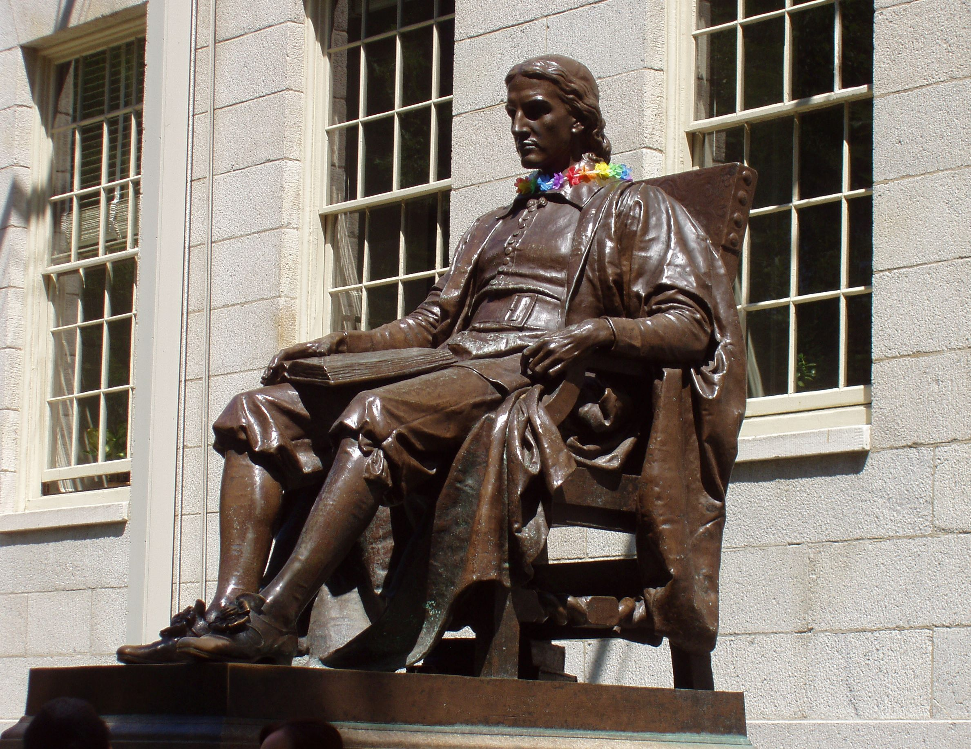

Slide 3


Slide 4
Convention
Over Configuration

Slide 5


Slide 6
Typical Web.config File
<?xml version="1.0"?>
<configuration xmlns="http://schemas.microsoft.com/.NetConfiguration/v2.0">
<configSections>
<sectionGroup name="system.web.extensions" type="System.Web.Configuration.SystemWebExtensionsSectionGroup, System.Web.Extensions, Version=3.5.0.0, Culture=neutral, PublicKeyToken=31BF3856AD364E35">
<sectionGroup name="scripting" type="System.Web.Configuration.ScriptingSectionGroup, System.Web.Extensions, Version=3.5.0.0, Culture=neutral, PublicKeyToken=31BF3856AD364E35">
<section name="scriptResourceHandler" type="System.Web.Configuration.ScriptingScriptResourceHandlerSection, System.Web.Extensions, Version=3.5.0.0, Culture=neutral, PublicKeyToken=31BF3856AD364E35" requirePermission="false" allowDefinition="MachineToApplication"/>
<sectionGroup name="webServices" type="System.Web.Configuration.ScriptingWebServicesSectionGroup, System.Web.Extensions, Version=3.5.0.0, Culture=neutral, PublicKeyToken=31BF3856AD364E35">
<section name="jsonSerialization" type="System.Web.Configuration.ScriptingJsonSerializationSection, System.Web.Extensions, Version=3.5.0.0, Culture=neutral, PublicKeyToken=31BF3856AD364E35" requirePermission="false" allowDefinition="Everywhere"/>
<section name="profileService" type="System.Web.Configuration.ScriptingProfileServiceSection, System.Web.Extensions, Version=3.5.0.0, Culture=neutral, PublicKeyToken=31BF3856AD364E35" requirePermission="false" allowDefinition="MachineToApplication"/>
<section name="authenticationService" type="System.Web.Configuration.ScriptingAuthenticationServiceSection, System.Web.Extensions, Version=3.5.0.0, Culture=neutral, PublicKeyToken=31BF3856AD364E35" requirePermission="false" allowDefinition="MachineToApplication"/>
<section name="roleService" type="System.Web.Configuration.ScriptingRoleServiceSection, System.Web.Extensions, Version=3.5.0.0, Culture=neutral, PublicKeyToken=31BF3856AD364E35" requirePermission="false" allowDefinition="MachineToApplication"/>
</sectionGroup>
</sectionGroup>
</sectionGroup>
</configSections>
<connectionStrings>
<!-- SQL connection string for Profile database -->
<add name="SQLProfileConnString" connectionString="server=(local);database=MSPetShop4;Integrated Security=SSPI;" providerName="System.Data.SqlClient"/>
<!-- SQL connection string for Membership database -->
<add name="SQLMembershipConnString" connectionString="server=(local);database=MSPetShop4Services;Integrated Security=SSPI;" providerName="System.Data.SqlClient"/>
<!-- SQL connection string for Inventory database lookup -->
<add name="SQLConnString1" connectionString="server=(local);database=MSPetShop4;Integrated Security=SSPI;" providerName="System.Data.SqlClient"/>
<!-- SQL connection string for handling transactions on the Inventory database-->
<add name="SQLConnString2" connectionString="server=(local);database=MSPetShop4;Integrated Security=SSPI;" providerName="System.Data.SqlClient"/>
<!-- SQL connection string for Orders database-->
<add name="SQLConnString3" connectionString="server=(local);database=MSPetShop4;Integrated Security=SSPI;" providerName="System.Data.SqlClient"/>
</connectionStrings>
<appSettings>
<!-- Enable data caching -->
<add key="EnableCaching" value="true"/>
<!-- Cache duration (in hours-whole number only) -->
<add key="CategoryCacheDuration" value="12"/>
<add key="ProductCacheDuration" value="12"/>
<add key="ItemCacheDuration" value="12"/>
<!-- Cache dependency options. Possible values: PetShop.TableCacheDependency - SQL Server and keep empty for ORACLE -->
<add key="CacheDependencyNamespace" value="PetShop.Infrastructure.Cache"/>
<!-- CacheDatabaseName should match the name under caching section, when using TableCacheDependency -->
<add key="CacheDatabaseName" value="MSPetShop4"/>
<!-- *TableDependency lists table dependency for each instance separated by comma -->
<add key="CategoryTableDependency" value="Category"/>
<add key="ProductTableDependency" value="Product,Category"/>
<add key="ItemTableDependency" value="Product,Category,Item"/>
<!-- Order processing options (Asynch/Synch) -->
<add key="OrderStrategyAssembly" value="PetShop"/>
<add key="OrderStrategyClass" value="PetShop.Repositories.OrderSynchronous"/>
<!-- Asynchronous Order options -->
<add key="OrderMessaging" value="PetShop.MSMQMessaging"/>
<add key="OrderQueuePath" value="FormatName:DIRECT=OS:MachineName\Private$\PSOrders"/>
<!-- Application Error Log -->
<add key="Event Log Source" value=".NET Pet Shop Evolved 5.0"/>
</appSettings>
<system.web>
<pages theme="PetShop" styleSheetTheme="PetShop">
<controls>
<add tagPrefix="asp" namespace="System.Web.UI" assembly="System.Web.Extensions, Version=3.5.0.0, Culture=neutral, PublicKeyToken=31BF3856AD364E35"/>
<add tagPrefix="asp" namespace="System.Web.UI.WebControls" assembly="System.Web.Extensions, Version=3.5.0.0, Culture=neutral, PublicKeyToken=31BF3856AD364E35"/>
</controls>
</pages>
<!--
Set compilation debug="true" to insert debugging
symbols into the compiled page. Because this
affects performance, set this value to true only
during development.
-->
<compilation debug="true">
<assemblies>
<add assembly="System.Data.OracleClient, Version=2.0.0.0, Culture=neutral, PublicKeyToken=B77A5C561934E089"/>
<add assembly="System.Transactions, Version=2.0.0.0, Culture=neutral, PublicKeyToken=B77A5C561934E089"/>
<add assembly="Accessibility, Version=2.0.0.0, Culture=neutral, PublicKeyToken=B03F5F7F11D50A3A"/>
<add assembly="System.Messaging, Version=2.0.0.0, Culture=neutral, PublicKeyToken=B03F5F7F11D50A3A"/>
<add assembly="System.Core, Version=3.5.0.0, Culture=neutral, PublicKeyToken=B77A5C561934E089"/>
<add assembly="System.Web.Extensions, Version=3.5.0.0, Culture=neutral, PublicKeyToken=31BF3856AD364E35"/>
<add assembly="System.Xml.Linq, Version=3.5.0.0, Culture=neutral, PublicKeyToken=B77A5C561934E089"/>
<add assembly="System.Data.DataSetExtensions, Version=3.5.0.0, Culture=neutral, PublicKeyToken=B77A5C561934E089"/>
</assemblies>
</compilation>
<!--
The <authentication> section enables configuration
of the security authentication mode used by
ASP.NET to identify an incoming user.
-->
<authentication mode="Forms">
<forms name="PetShopAuth" loginUrl="SignIn.aspx" protection="None" timeout="60"/>
</authentication>
<!--
The <customErrors> section enables configuration
of what to do if/when an unhandled error occurs
during the execution of a request. Specifically,
it enables developers to configure html error pages
to be displayed in place of a error stack trace.
-->
<customErrors defaultRedirect="Error.aspx" mode="RemoteOnly"/>
<sessionState mode="Off"/>
<anonymousIdentification enabled="true"/>
<profile automaticSaveEnabled="false" defaultProvider="ShoppingCartProvider">
<providers>
<add name="ShoppingCartProvider" connectionStringName="SQLProfileConnString" type="PetShop.Profile.PetShopProfileProvider" applicationName=".NET Pet Shop 5.0"/>
<add name="WishListProvider" connectionStringName="SQLProfileConnString" type="PetShop.Profile.PetShopProfileProvider" applicationName=".NET Pet Shop 5.0"/>
<add name="AccountInfoProvider" connectionStringName="SQLProfileConnString" type="PetShop.Profile.PetShopProfileProvider" applicationName=".NET Pet Shop 5.0"/>
</providers>
<properties>
<add name="ShoppingCart" type="PetShop.Domain.Cart" allowAnonymous="true" provider="ShoppingCartProvider"/>
<add name="WishList" type="PetShop.Domain.Cart" allowAnonymous="true" provider="WishListProvider"/>
<add name="AccountInfo" type="PetShop.Domain.AddressInfo" allowAnonymous="false" provider="AccountInfoProvider"/>
</properties>
</profile>
<membership defaultProvider="SQLMembershipProvider">
<providers>
<add name="SQLMembershipProvider" type="System.Web.Security.SqlMembershipProvider" connectionStringName="SQLMembershipConnString" applicationName=".NET Pet Shop 5.0" enablePasswordRetrieval="false" enablePasswordReset="true" requiresQuestionAndAnswer="false" requiresUniqueEmail="false" passwordFormat="Hashed"/>
</providers>
</membership>
<!--
<membership defaultProvider="OracleMembershipProvider">
<providers>
<clear/>
<add name="OracleMembershipProvider"
type="PetShop.Membership.OracleMembershipProvider"
connectionStringName="OraMembershipConnString"
enablePasswordRetrieval="false"
enablePasswordReset="false"
requiresUniqueEmail="false"
requiresQuestionAndAnswer="false"
minRequiredPasswordLength="7"
minRequiredNonalphanumericCharacters="1"
applicationName=".NET Pet Shop Evolved 5.0"
hashAlgorithmType="SHA1"
passwordFormat="Hashed"/>
</providers>
</membership>
-->
<caching>
<sqlCacheDependency enabled="true" pollTime="10000">
<databases>
<add name="MSPetShop4" connectionStringName="SQLConnString1" pollTime="10000"/>
</databases>
</sqlCacheDependency>
</caching>
<httpHandlers>
<remove verb="*" path="*.asmx"/>
<add verb="*" path="*.asmx" validate="false" type="System.Web.Script.Services.ScriptHandlerFactory, System.Web.Extensions, Version=3.5.0.0, Culture=neutral, PublicKeyToken=31BF3856AD364E35"/>
<add verb="*" path="*_AppService.axd" validate="false" type="System.Web.Script.Services.ScriptHandlerFactory, System.Web.Extensions, Version=3.5.0.0, Culture=neutral, PublicKeyToken=31BF3856AD364E35"/>
<add verb="GET,HEAD" path="ScriptResource.axd" validate="false" type="System.Web.Handlers.ScriptResourceHandler, System.Web.Extensions, Version=3.5.0.0, Culture=neutral, PublicKeyToken=31BF3856AD364E35"/>
</httpHandlers>
<httpModules>
<add name="ScriptModule" type="System.Web.Handlers.ScriptModule, System.Web.Extensions, Version=3.5.0.0, Culture=neutral, PublicKeyToken=31BF3856AD364E35"/>
</httpModules>
</system.web>
<location path="UserProfile.aspx">
<system.web>
<authorization>
<deny users="?"/>
</authorization>
</system.web>
</location>
<location path="CheckOut.aspx">
<system.web>
<authorization>
<deny users="?"/>
</authorization>
</system.web>
</location>
<system.codedom>
<compilers>
<compiler language="c#;cs;csharp" extension=".cs" type="Microsoft.CSharp.CSharpCodeProvider,System, Version=2.0.0.0, Culture=neutral, PublicKeyToken=b77a5c561934e089" warningLevel="4">
<providerOption name="CompilerVersion" value="v3.5"/>
<providerOption name="WarnAsError" value="false"/>
</compiler>
<compiler language="vb;vbs;visualbasic;vbscript" extension=".vb" type="Microsoft.VisualBasic.VBCodeProvider, System, Version=2.0.0.0, Culture=neutral, PublicKeyToken=b77a5c561934e089" warningLevel="4">
<providerOption name="CompilerVersion" value="v3.5"/>
<providerOption name="OptionInfer" value="true"/>
<providerOption name="WarnAsError" value="false"/>
</compiler>
</compilers>
</system.codedom>
<system.webServer>
<validation validateIntegratedModeConfiguration="false"/>
<modules>
<remove name="ScriptModule"/>
<add name="ScriptModule" preCondition="managedHandler" type="System.Web.Handlers.ScriptModule, System.Web.Extensions, Version=3.5.0.0, Culture=neutral, PublicKeyToken=31BF3856AD364E35"/>
</modules>
<handlers>
<remove name="WebServiceHandlerFactory-Integrated"/>
<remove name="ScriptHandlerFactory"/>
<remove name="ScriptHandlerFactoryAppServices"/>
<remove name="ScriptResource"/>
<add name="ScriptHandlerFactory" verb="*" path="*.asmx" preCondition="integratedMode" type="System.Web.Script.Services.ScriptHandlerFactory, System.Web.Extensions, Version=3.5.0.0, Culture=neutral, PublicKeyToken=31BF3856AD364E35"/>
<add name="ScriptHandlerFactoryAppServices" verb="*" path="*_AppService.axd" preCondition="integratedMode" type="System.Web.Script.Services.ScriptHandlerFactory, System.Web.Extensions, Version=3.5.0.0, Culture=neutral, PublicKeyToken=31BF3856AD364E35"/>
<add name="ScriptResource" verb="GET,HEAD" path="ScriptResource.axd" preCondition="integratedMode" type="System.Web.Handlers.ScriptResourceHandler, System.Web.Extensions, Version=3.5.0.0, Culture=neutral, PublicKeyToken=31BF3856AD364E35"/>
</handlers>
</system.webServer>
<runtime>
<assemblyBinding xmlns="urn:schemas-microsoft-com:asm.v1">
<dependentAssembly>
<assemblyIdentity name="System.Web.Extensions" publicKeyToken="31bf3856ad364e35"/>
<bindingRedirect oldVersion="1.0.0.0-1.1.0.0" newVersion="3.5.0.0"/>
</dependentAssembly>
<dependentAssembly>
<assemblyIdentity name="System.Web.Extensions.Design" publicKeyToken="31bf3856ad364e35"/>
<bindingRedirect oldVersion="1.0.0.0-1.1.0.0" newVersion="3.5.0.0"/>
</dependentAssembly>
</assemblyBinding>
</runtime>
</configuration>

Slide 7
Configuration-Based
.NET historically configuration-based
  App/web.config
  IoC config
  ORM config
  Mappers
  Event handlers

Slide 8


Slide 9


Slide 10


Slide 11
Rails ActiveRecord
class Product < ActiveRecord::Base; end
...can be automatically mapped to:
CREATE TABLE products (
id int(11) NOT NULL auto_increment,
name varchar(255),
PRIMARY KEY (id) );
Object model automatically has Product#name property.

Slide 12
Associations in Rails ActiveRecord
class Firm < ActiveRecord::Base
has_many :clients
has_one :account
belongs_to :conglomorate
end

Slide 14
Conventions in an Agile World
NHibernate / Fluent NHibernate
Jimmy Bogard’s AutoMapper
Castle Windsor
ASP.NET MVC
jQuery

Slide 15
DEMO

Slide 16


Slide 17
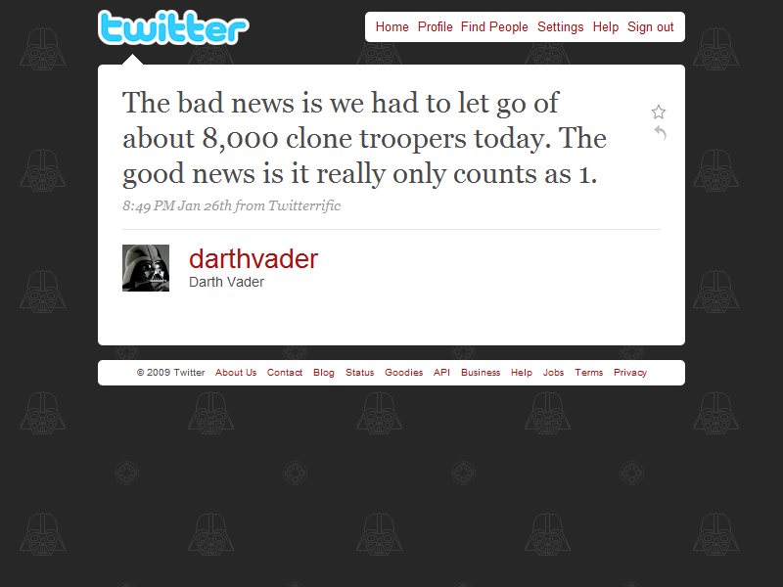

Slide 18
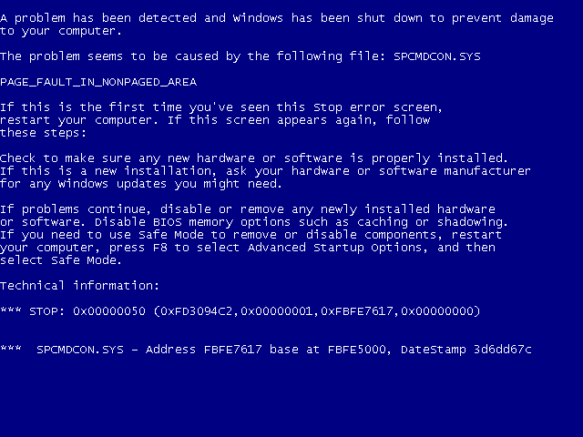

Slide 19
Resources
Fluent NHibernate (http://www.fluentnhibernate.org)
NHForge (http://nhforge.org)
AutoMapper (http://www.codeplex.com/AutoMapper)
Castle Windsor (http://castleproject.org)
ASP.NET MVC (http://asp.net/mvc)
jQuery (http://jquery.com)

Slide 20

Questions
James Kovacs
JamesKovacs.com
Pluralsight.com
jkovacs@post.harvard.edu
@jameskovacs

